Slide 1
Updates For Parents and Caretaker Relatives living with a Dependent Child

Slide 2
Purpose:
Clarify the policy change for Parents and caretaker relatives eligible for MAGI-Medicaid if there is a dependent child living in home
Objectives:
At the end of this presentation you will be able to
Understand the categories that have been modified
Recite the MAGI -Adult Requirements
Have a clear understanding of Minimum Essential Coverage
Explain how this change will be communicated
Notes:
This Policy change is effective 10/1

Slide 3
Who
Parents and other caretaker relatives living with dependent children
The MAGI-Adult expansion category: for those whose income ranges from 69% to 133% of the federal poverty level

Slide 4
Why
To ensure parents and other caretaker relatives living with a dependent child will be eligible to receive MAGI-Medicaid only if the child is receiving benefits under Medicaid, Child Health Plan Plus, through the Exchange, or otherwise enrolled in minimum essential coverage.

Slide 5
Minimum Essential Coverage (MEC)
Dependent child must be enrolled in health coverage known as MEC.
Examples of Minimum Essential Coverage (MEC):
Health First Colorado (Colorado’s Medicaid Program)
Child Health Plan Plus (CHP+)
Private health plans through Connect for Health Colorado
Health insurance through a job

Slide 6
How (existing members will be affected)
Scenario: Parent currently enrolled in MAGI-Adult category with dependent child living in the home, but did not request Medical assistance for dependent child
- Valid Health Care Coverage record for dependent child exists
- Parent remains enrolled in MAGI Adult category
- No valid Health Care Coverage record in CBMS
- CBMS sets MEC question to ‘Unknown’
- VCL generated
- Adult’s status Pending, 10+5 days
Notes:
Green: No other action required
Red: Adult’s status set to Pending and 10 + 5 days when VCL sent. While ‘Pending’ they will not be evaluated for Marketplace.
Verification not received by due date, MEC question updated to ‘No’
Parent denied MAGI-Adult with denial reason “Dependent child with no MEC”
10 day noticing will be applied before terminating member.

Slide 7
How (applicants will be affected)
Scenario: New applicant is parent with dependent child living in the home but not requesting Medical Assistance for dependent child
- Parent indicates dependent child has health care coverage
- Set MEC question to ‘Yes’
- Parent eligible for Adult MAGI category
- No information about dependent child’s health care coverage provided
- Set MEC question to ‘Unknown’
- VCL generated
- Adult’s status Pending, 10 days
- Verification not received by due date, MEC question set to ‘No’
- Parent denied for MAGI Adult category
Notes:
Green: No other action required
Red: Adult’s status set to Pending and 10 + 5 days when VCL sent. While ‘Pending’ they will not be evaluated for Marketplace.
Verification not received by due date, MEC question updated to ‘No’
Parent denied MAGI-Adult with denial reason “Dependent child with no MEC”
10 day noticing will be applied before terminating member.

Slide 8
What is a Valid Health Coverage Record?
Enrollment in one of the following health insurance types:
Other Government-sponsored coverage
Employer-sponsored coverage
COBRA
Current employer coverage
Peace Corps
Railroad Retirement
Retiree coverage
TRICARE
VA Retiree
Notes:
A valid record must have a coverage begin date during or before the application month and if there is an end date it must be after the application month

Slide 9
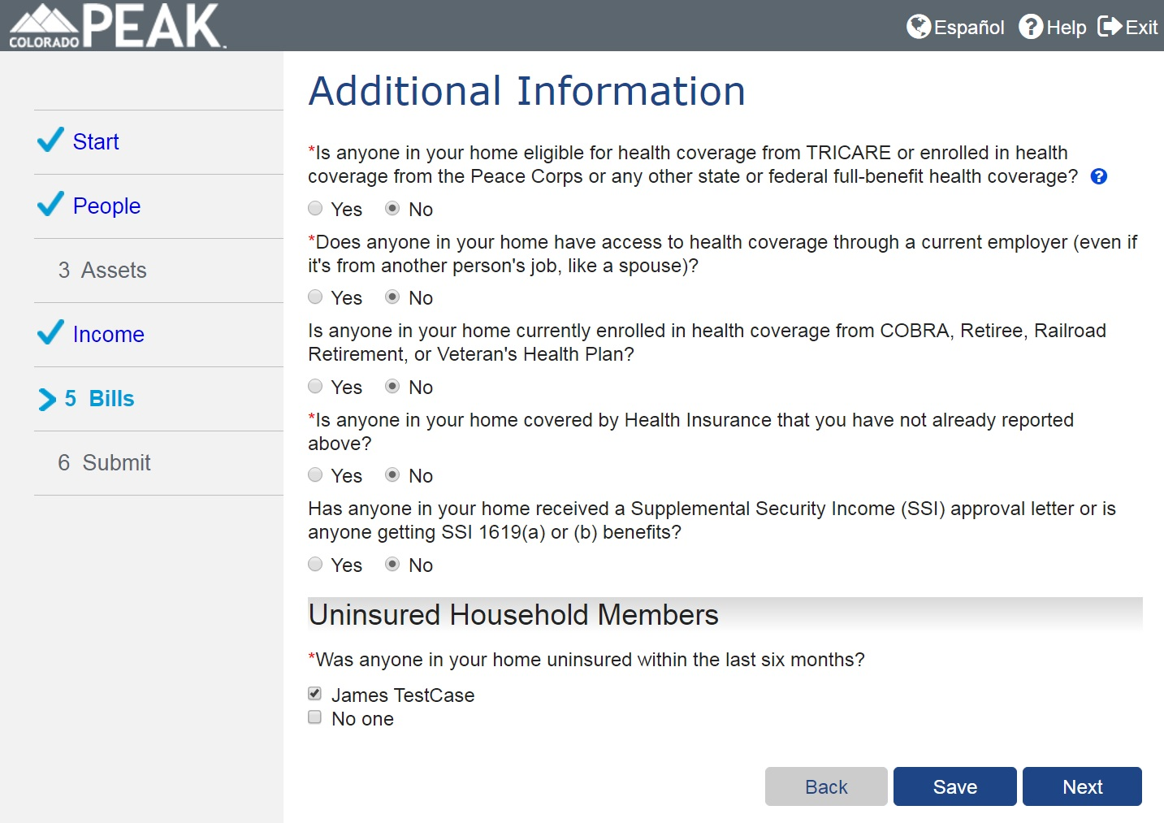
Valid Health Coverage Record
Notes:
These types of health coverage records are captured on the Additional Information page in PEAK

Slide 10
Changes to PEAK

Slide 11
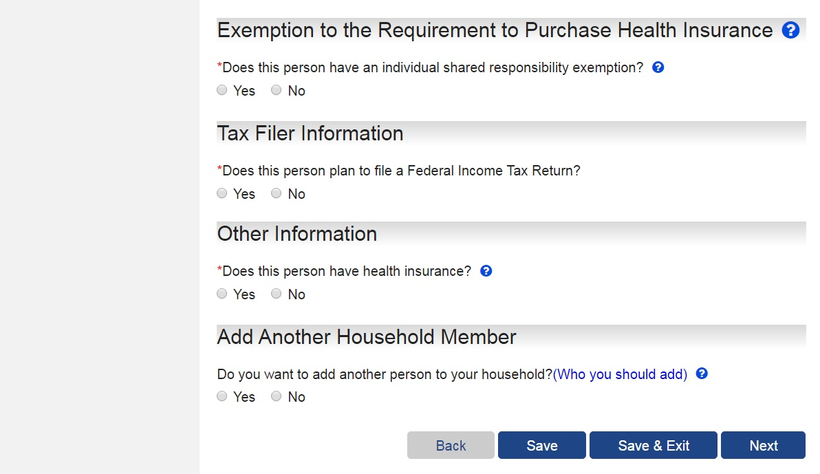
AFB: Household Member Detail Page
Required for MA Only Applications
Optional for MA Combo Applications
Notes:
For applications that contain Medical Assistance, a new question will now display on the Household Member Detail page for children up to 19 years old, through their birth month, who are not requesting assistance. If the child is included as applying for Medical Assistance, this “Other Information” section will not display.
Under the Other Information heading, the new question reads: “Does this person have health insurance?”
The question will be mandatory for Medical Assistance only applications and optional for Medical Assistance combo application.

Slide 12
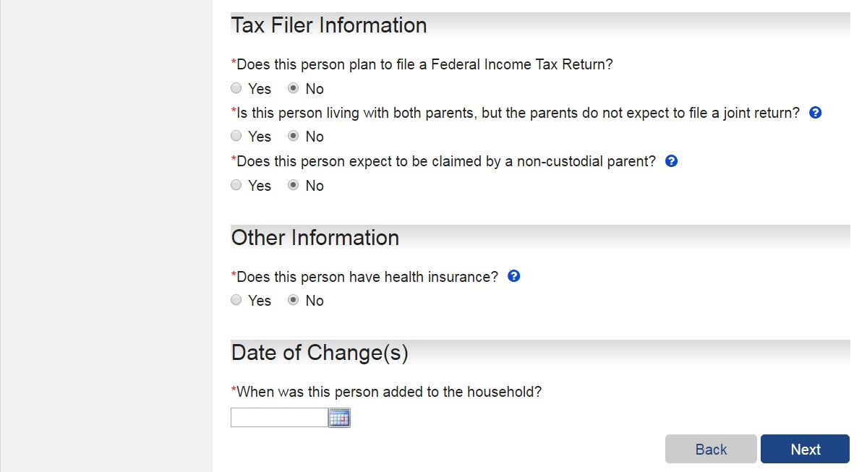
RMC: Household Member Detail Page
Required for MA Only Applications
Optional for MA Combo Applications
Notes:
In Report My Changes, the new question will display when a child age 19 or under is in the home, but is not requesting Medical Assistance.
If the child is included as applying for Medical Assistance, this “Other Information” section will not display.

Slide 13
Help Text
Help Text:
“What is Minimum Essential Coverage (MEC)? Under the Affordable Care Act (federal health care reform law), most individuals are required to have qualifying health care coverage, known as minimum essential coverage (MEC), or pay an Internal Revenue Service (IRS) federal tax penalty. Examples of minimum essential coverage include most Health First Colorado (Colorado's Medicaid Program), CHP+, private health plans through Connect for Health Colorado, and job-based health insurance. Read about other types of health coverage that qualify as MEC.”
Notes:
Detailed help hover text has been added for the new question about Minimum Essential Coverage.

Slide 14
Medical Assistance Only Application
Household with Child <19 who is not requesting benefits
Does this person [child] have health insurance?
Yes
No
Parent/Caretaker will not be denied Medical Assistance
Valid Health Coverage Record in CBMS?
Yes
No
Parent/Caretaker will not be denied Medical Assistance
Parent/Caretaker will be denied Medical Assistance
Notes:
For those of you interested in what goes on behind the scenes, I am going summarize how the system will review the information to determine if the Minimum Essential Coverage requirement has been met.
For a Medical Assistance only application, if a child ages 19 or under is in the home and is not applying for Medical Assistance, the new “Does this person have health insurance” question will be queued on the Household Member Details page as a required question.
If yes is selected, indicating the child has minimum essential coverage, the parent/caretaker relative will not be denied for Medical Assistance.
If no is selected, indicating the child does not have Minimum Essential Coverage, the system will then verify if there is a valid health coverage record for the individual in CBMS. If a valid health coverage record does not exist, the parent/caretaker relative will be denied for Medical Assistance.

Slide 15
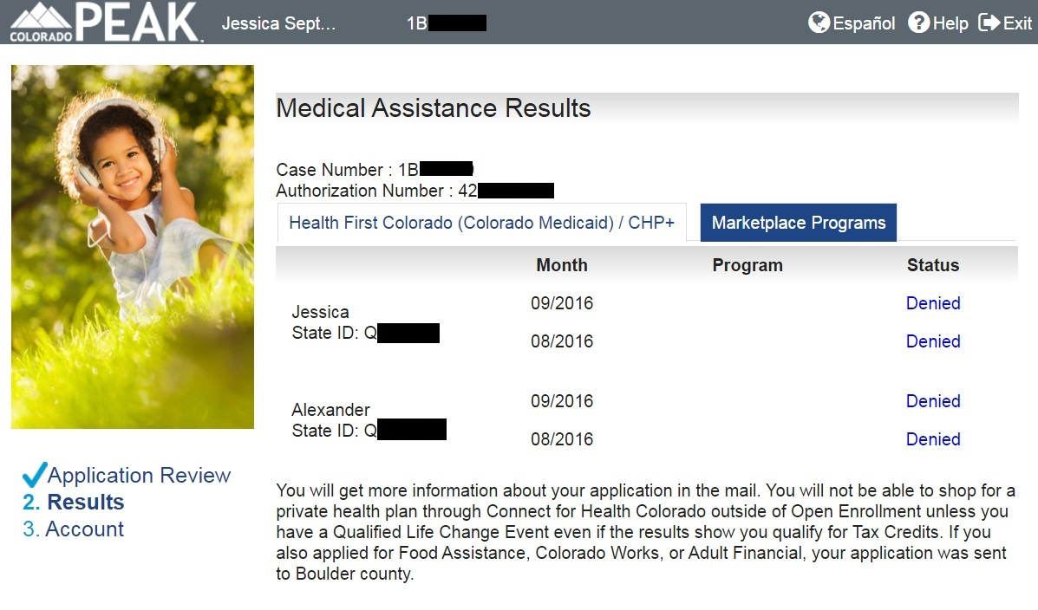
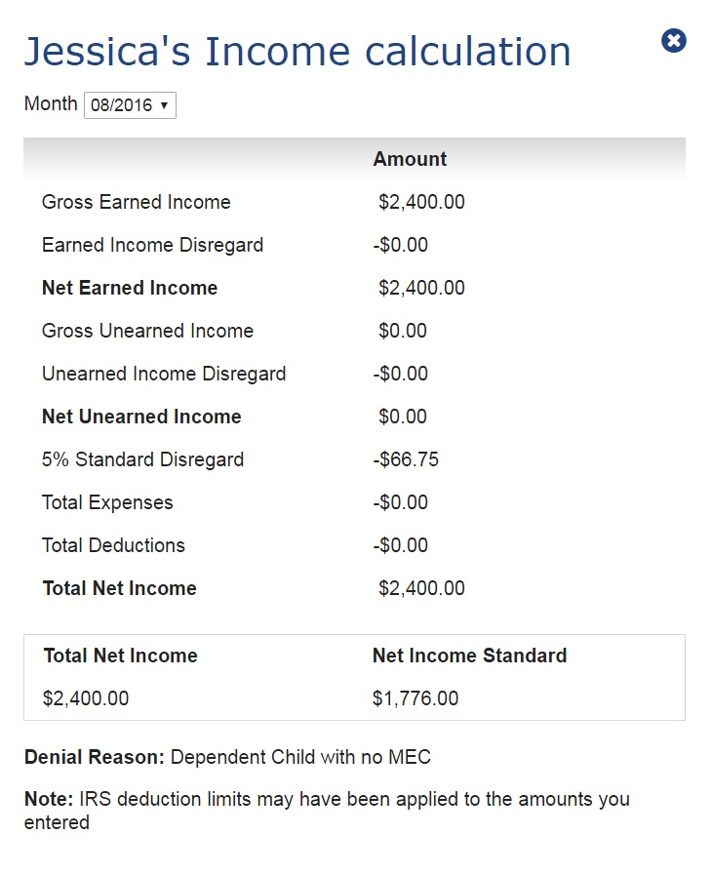
Results
Notes:
In the instance a parent/caretaker relative is denied, because a child does not have minimum essential coverage, the denial reason will display on the income calculation on the results page.

Slide 16
Medical Assistance Combo Application
Household with Child <19 who is not requesting benefits
Does this person [child] have health insurance?
Yes
No
No Response=Unknown
Parent/Caretaker will not be denied Medical Assistance
Parent/Caretaker will be denied Medical Assistance
Verification checklist will be sent (see below)
Verification of MEC due within 10 business days.
While pending for proof of MEC for child:
the parent/caretaker will not be evaluated for Marketplace Programs.
If verification is not returned, parent/caretaker relative will be denied for missing verifications.
Notes:
For a Medical Assistance combo application, if a child ages 19 or under is in the home and is not applying for Medical Assistance, the new “Does this person have health insurance” question will be queued on the Household Member Details page as an optional question.
In the instance that the question is not answered, a verification checklist will be sent to the household and the child will be listed as requiring verification of Minimum Essential Coverage. The verification of MEC will be due within 10 business days from the date the verification checklist is sent.
While pending for ‘missing verification’ for proof of MEC for their child, the individual will not be evaluated for Marketplace Programs. If verification is not returned within the provided timeframe, then the parent/caretaker relative will be denied for missing verifications.

Slide 17
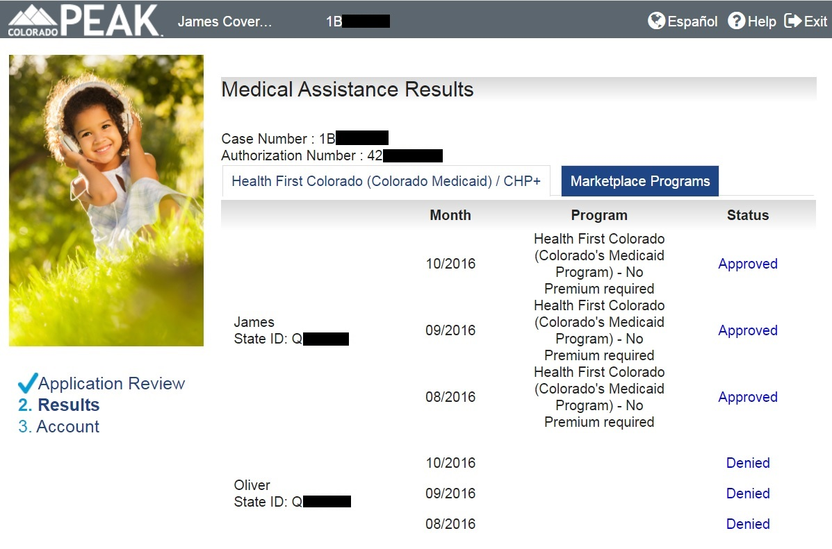
Notes:
In this example, the Medical Assistance results for the parent/caretaker is listed as “Approved”

Slide 18
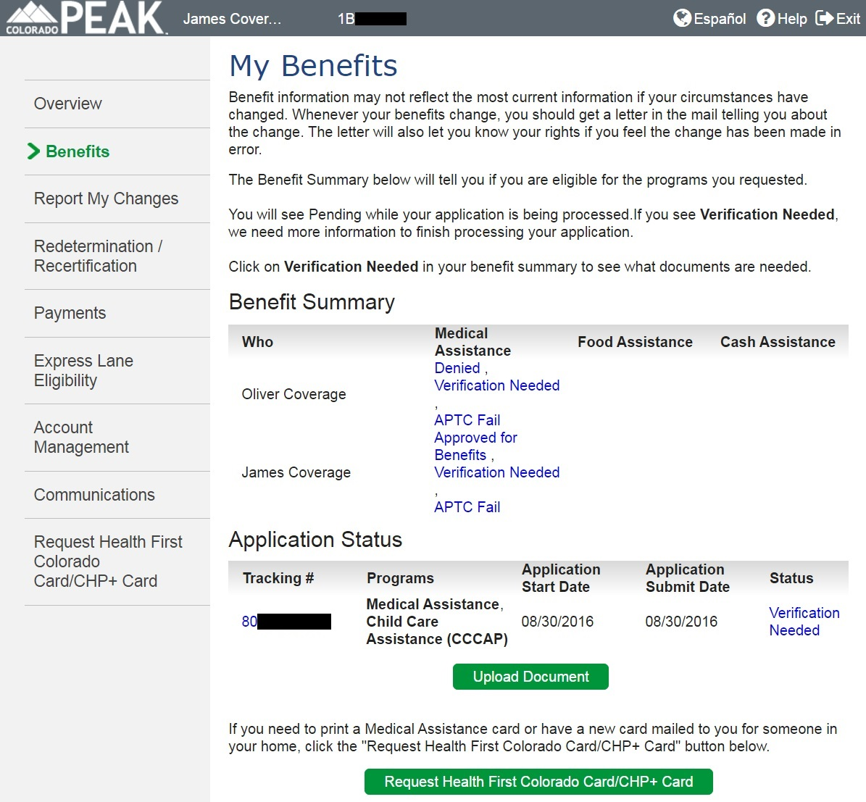
Notes:
However, once in their PEAK Account, the verification needed status is listed. By selecting the verification needed hyperlink….

Slide 19
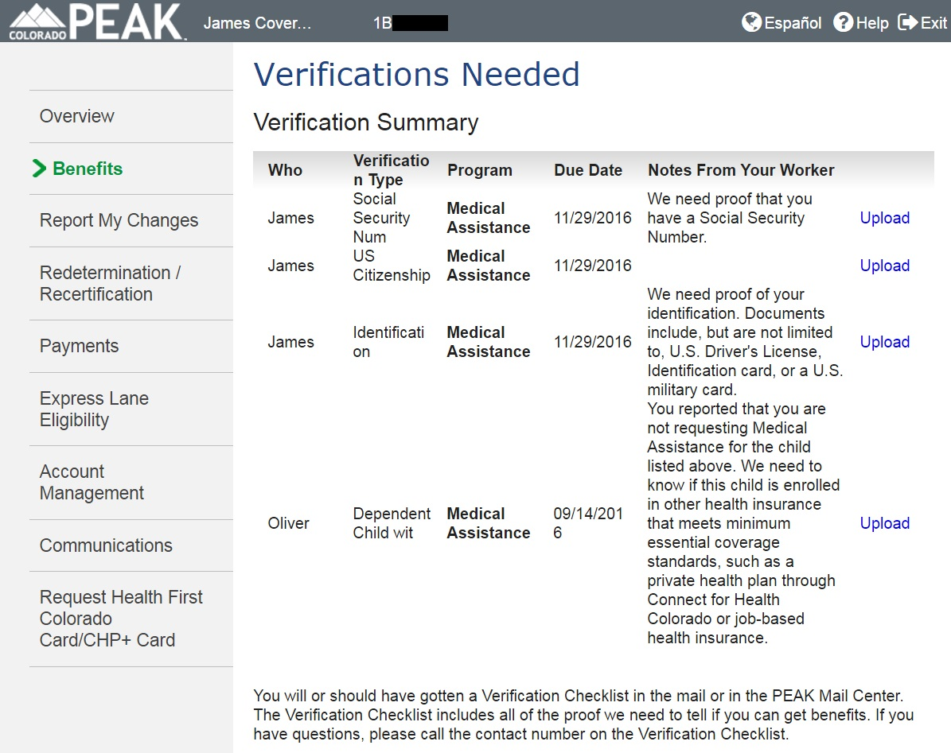
Notes:
If a child Then the verifications needed page will display the verifications needed, including the program for which it is required and the due date.
To reiterate, if a child age 19 or younger is in the home and is not requesting aid and the child’s Minimum Essential Coverage status is unknown, for example if the new minimum essential coverage question was not answered on a combo application, then a verification checklist will be generated to the household.
The child will be listed as requiring the item detail of, ‘Dependent Child with no MEC’ with a due date listed as 10 business days from the print date.
*Note: The verification checklist will be mailed to the parent/caretaker when the child’s MEC question = Unknown.

Slide 20
Requirement Updates

Slide 21
MAGI Parent & Caretaker Relative Category Updates
Current requirements
Net countable income less than or equal to 68% FPL
Must be a Parent or Responsible relative of a dependent child and the child is receiving Medical Assistance
Individual has dependent child by blood, adoption or marriage, is living with that dependent child (living in the home), and assumes primary responsibility for that dependent child
Requirements effective October 1, 2016
Net countable income less than or equal to 68% FPL
Must be a Parent or Responsible relative of a dependent child
Individual has dependent child by blood, adoption or marriage, is living with that dependent child (living in the home), and assumes primary responsibility for that dependent child

Slide 22
MAGI Adult Category Updates
If individual is a parent/caretaker relative and net countable income is between 69% FPL to 133 % FPL, and
Individual has dependent child living in the home, and dependent child is enrolled in Health First Colorado (MAGI or Non-MAGI) or CHP+, or other Minimum Essential Coverage
Individual is not currently eligible under the Social Security Act, is not eligible for Medicare, and is not pregnant, and age is equal to or greater than 19 and less than 65

Slide 23
How will this change be communicated?

Slide 24
Informational Notice
The Department plans on sending parents & caretaker relatives who are currently enrolled in the MAGI-Adult category and who have a dependent child living in the home but did not request Medical Assistance for the dependent child an Informational notice on the policy change.
This notice will be sent out manually by the Department
This notice will be sent out in September prior to the implementation date of October 1,2016

Slide 25
[LETTER DATE]
[NAME]
[ADDRESS]
[CITY, STATE ZIP]
Subject: Action needed for your benefits
Dear [NAME]:
Our records show that you are a parent or relative living with and caring for a child under the age of 19. Our records also show that a child living in your home does not have minimum essential coverage. Starting on October 1, 2016, you will no longer be eligible for health insurance benefits from Health First Colorado (Colorado’s Medicaid Program), if any child living in your home is not enrolled in minimum essential coverage.
Minimum essential coverage is health insurance that covers all basic needed health services. Examples of minimum essential coverage include Health First Colorado (Colorado's Medicaid Program), Child Health Plan Plus (CHP+), private health insurance plans through Connect for Health Colorado, and health insurance through a job.
To keep your benefits after October 1, 2016, you must take one of the following actions below by October 1, 2016:
If the child living in your home is already enrolled in minimum essential coverage, contact your local county office of social/human services to report that the child already has minimum essential coverage. Find your county’s contact information at Colorado.gov/HCPF/Counties.
If the child living in your home does not have minimum essential coverage, enroll the child in minimum essential coverage and contact your local county office of social/human services to report that the child has been enrolled.
You can apply for Medical Assistance, including Medicaid and CHP+, and financial assistance to purchase private health insurance through Connect for Health Colorado, for the child living in your home on Colorado.gov/PEAK or by contacting your local county office of human/social services.
Open enrollment for Connect for Health Colorado will begin November 1, 2016 for more information visit: ConnectforHealthCO.com

Slide 26
Future Projects

Slide 27
Future Projects
In mid 2017 the Department will be implementing a second phase to this policy change to address parents who are enrolled/or will be eligible in the MAGI –Adult category and who have applied for MA for a dependent child living in home but the child ends up denied for MA.
The Department wants to generate a speed letter notifying this particular population about the policy change and to also give them an opportunity to report MEC for child.
The Department will provide further updates prior to implementation.

Slide 28
Mark Your Calendars
Support Call for Community Partners
Thursday, September 22, 2016
1.877.820.7831
Passcode: 349141#
3:00-3:45 pm
Notes:
Please join the state for the support call hosted for community partners.

Slide 29
THANK YOU!

